Slide 1
FRB Update #7
William Huang
(7/13/2020)

Slide 2
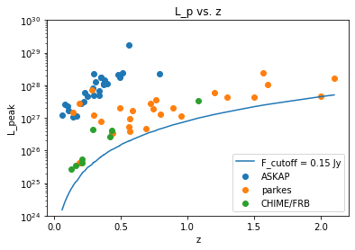
Associated Set
I updated my spreadsheet to be more understandable. N is the number of FRBs in the associated set, and the rank is using N+1 in the denominator. It is based on this graph, now including CHIME FRBs.

Slide 3
(cont.)
For the purple circled dot as shown, it looks like 20 FRBs are located within its associated set, and the rank is 12/21.

Slide 4
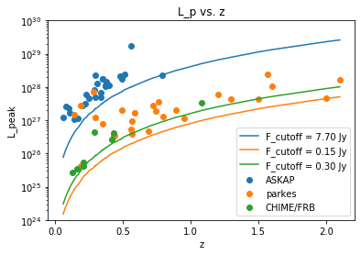
Each telescope, separate F_lim
For each telescope (ASKAP, CHIME, and Parkes) I set a unique F_lim. I used the updated value of g(Z). All of the data and the cutoffs are shown in the below graph:

Slide 5
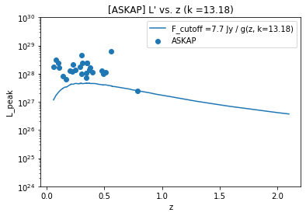
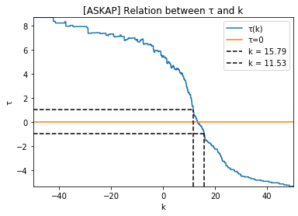
ASKAP
At a very large k=13.18, tau reaches 0. Unfortunately, the limit is no longer monotonic, so this is probably not valid.

Slide 6
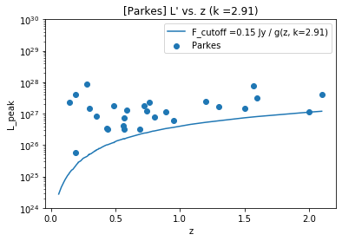
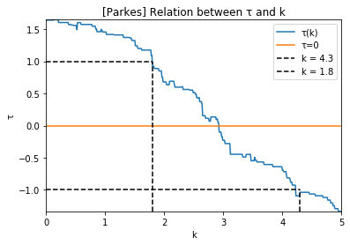
Parkes
For FRBs within Parkes, tau actually intersects 0 multiple times, the first one being k = 1.97. The associated graphs are shown here.

Slide 7
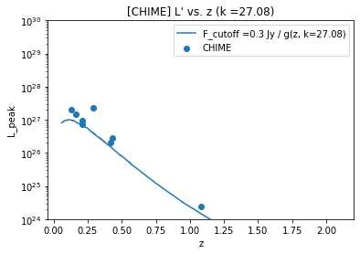
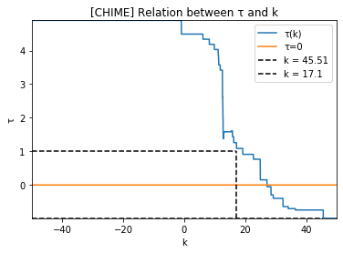
CHIME
CHIME has such a small sample size that the tau graph is very blocky. The k value for tau=0 also results in a non-monotonic limit, like ASKAP.

Slide 8
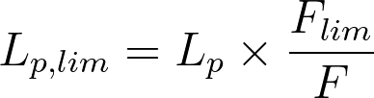
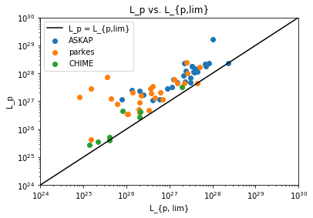
Combining all of them into one
Using the equation at the top right, I calculated L_lim for each telescope, and combined them into one dataset. The following is a graph of that:

Slide 9
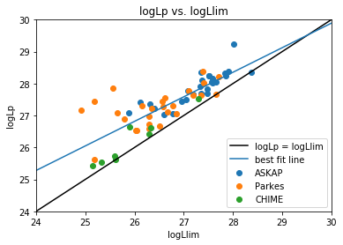
(cont.)
Fitting a best fit linear line for logLp vs. logLlim, we find y = 0.7685x + 6.835

Slide 10
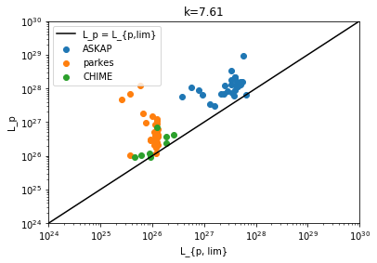
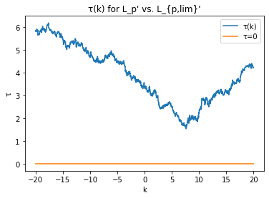
(cont.)
Unfortunately, despite defining L_lim separately for each telescope, and finding tau for a variety of k, no value of k satisfied tau = 0. Strangely, however, the lowest value of tau came at k=7.61, which almost separated the telescopes into groups.

